Slide 1
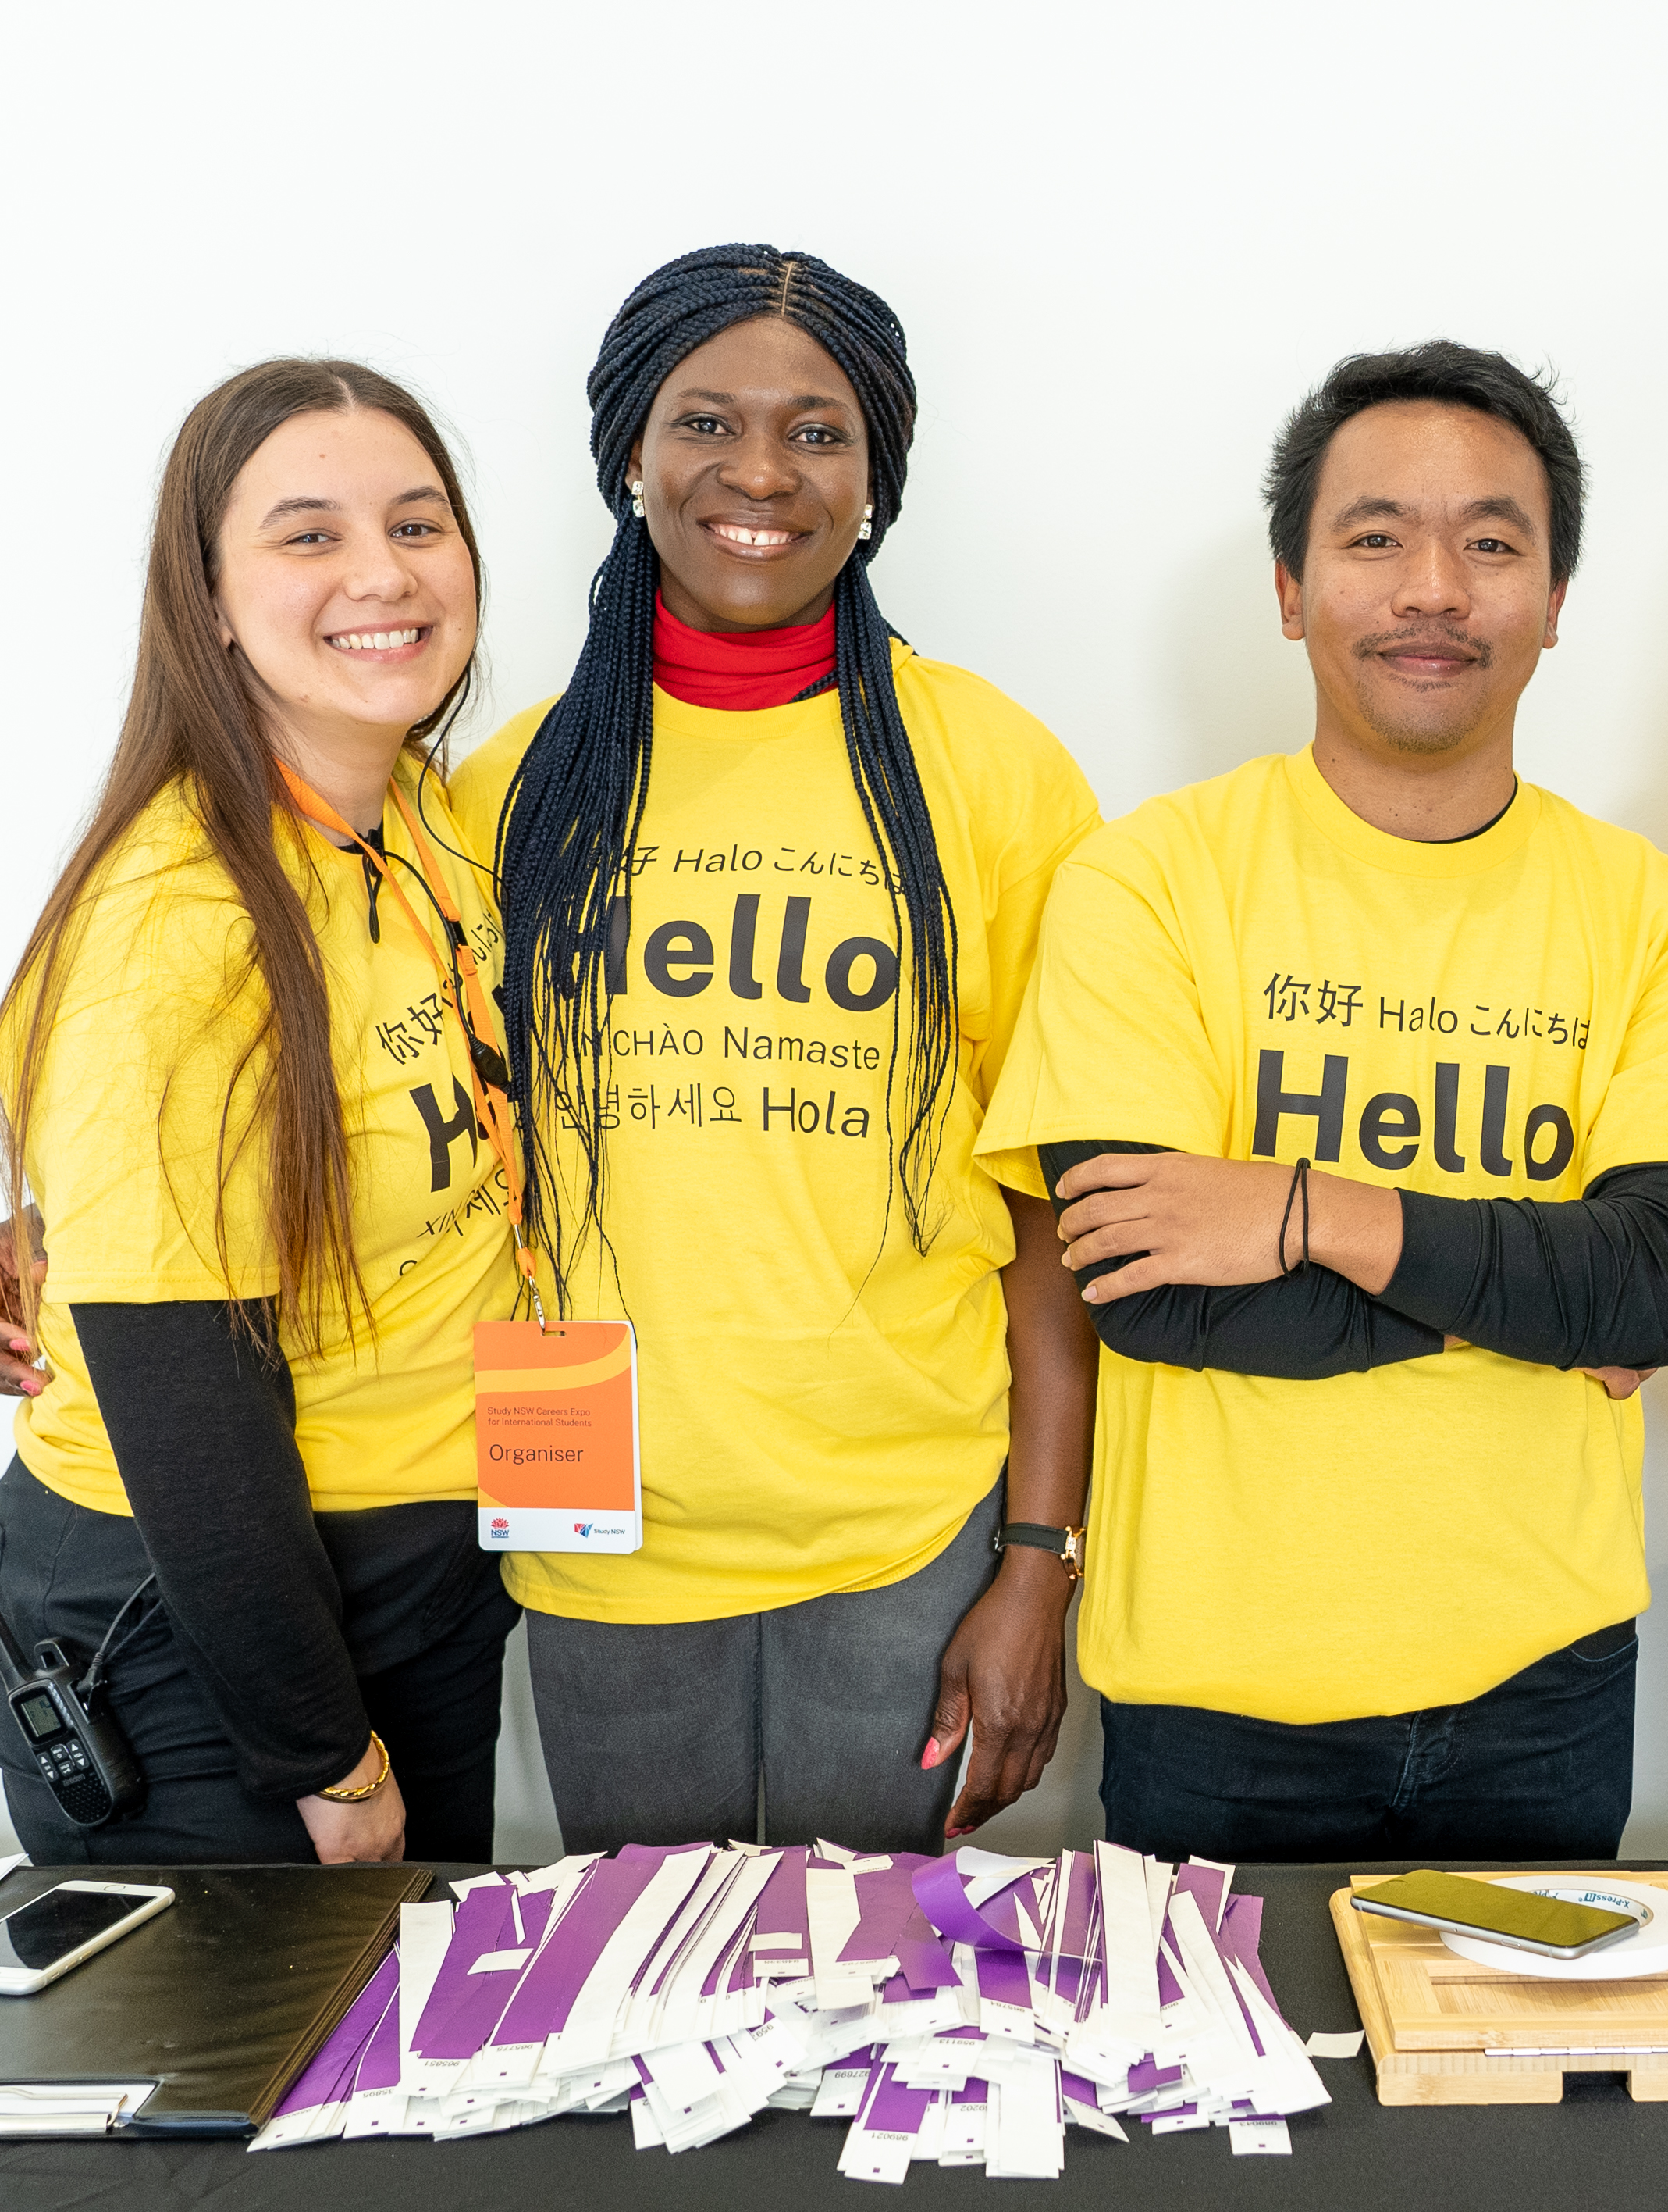
NSW International Student Airport Welcome Desks
Last updated: November 2023

Slide 2
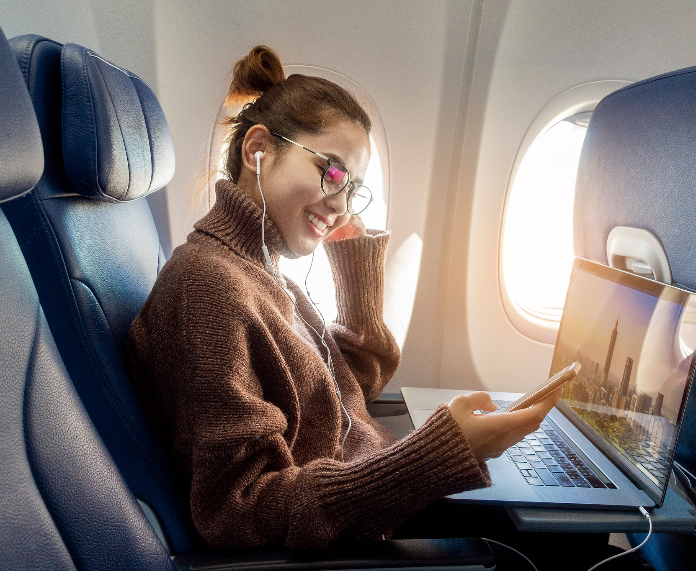

01
This section is for commencing international students

Slide 3

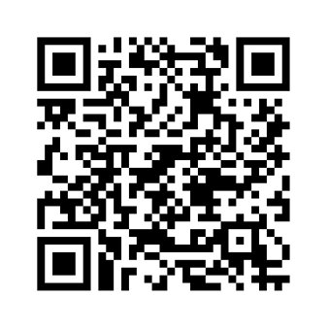
Visit the Airport Welcome Desks
Our International Student Welcome Desks welcome thousands of new students to Sydney and NSW each year. Drop by and say hello to our friendly team when you arrive.

Slide 4
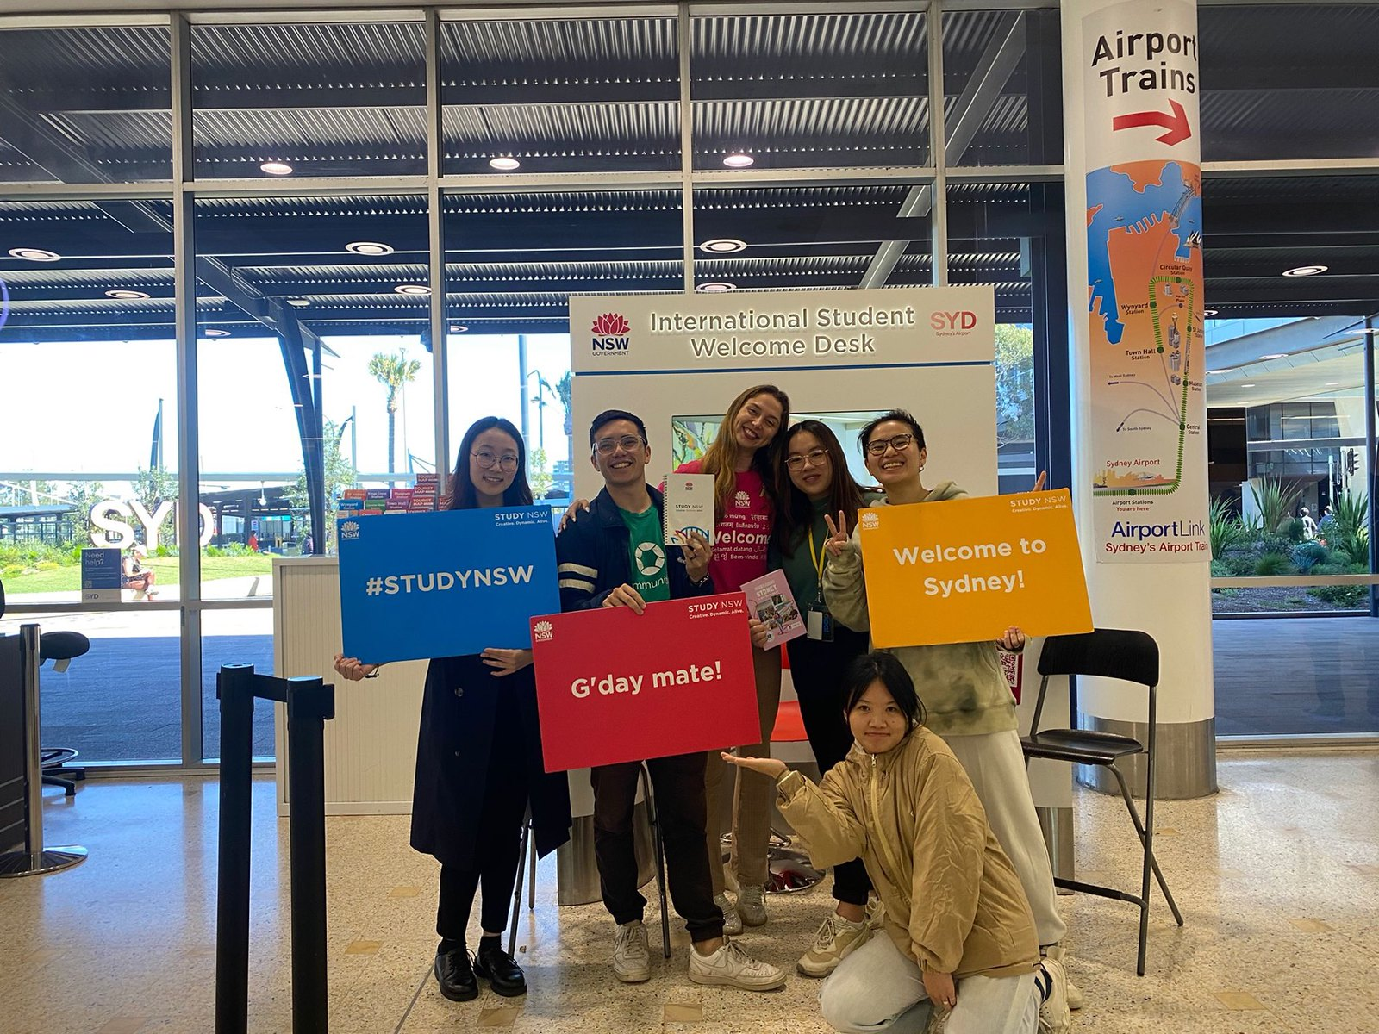
How to find the Airport Welcome Desks
Sydney Airport
Where: International Airport Arrivals Hall A, Terminal 1
When: Monday to Sunday, 7:00am to 1:00pm
Newcastle Airport
Where: Arrivals Hall
When: Peak student arrival times between
22 January and 4 February
12 and 27 February
6 and 12 May
8 and 21 July
19 and 25 August​

Slide 5
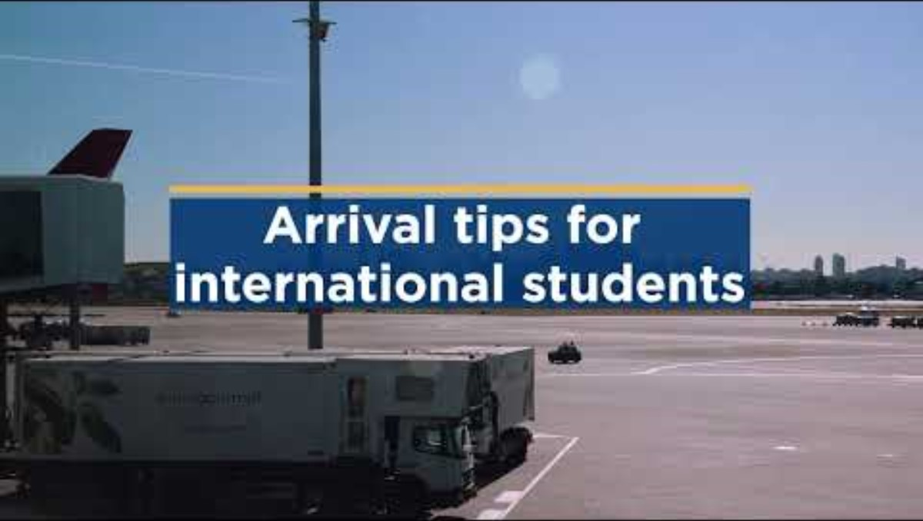
Arrival tips for international students

Slide 6
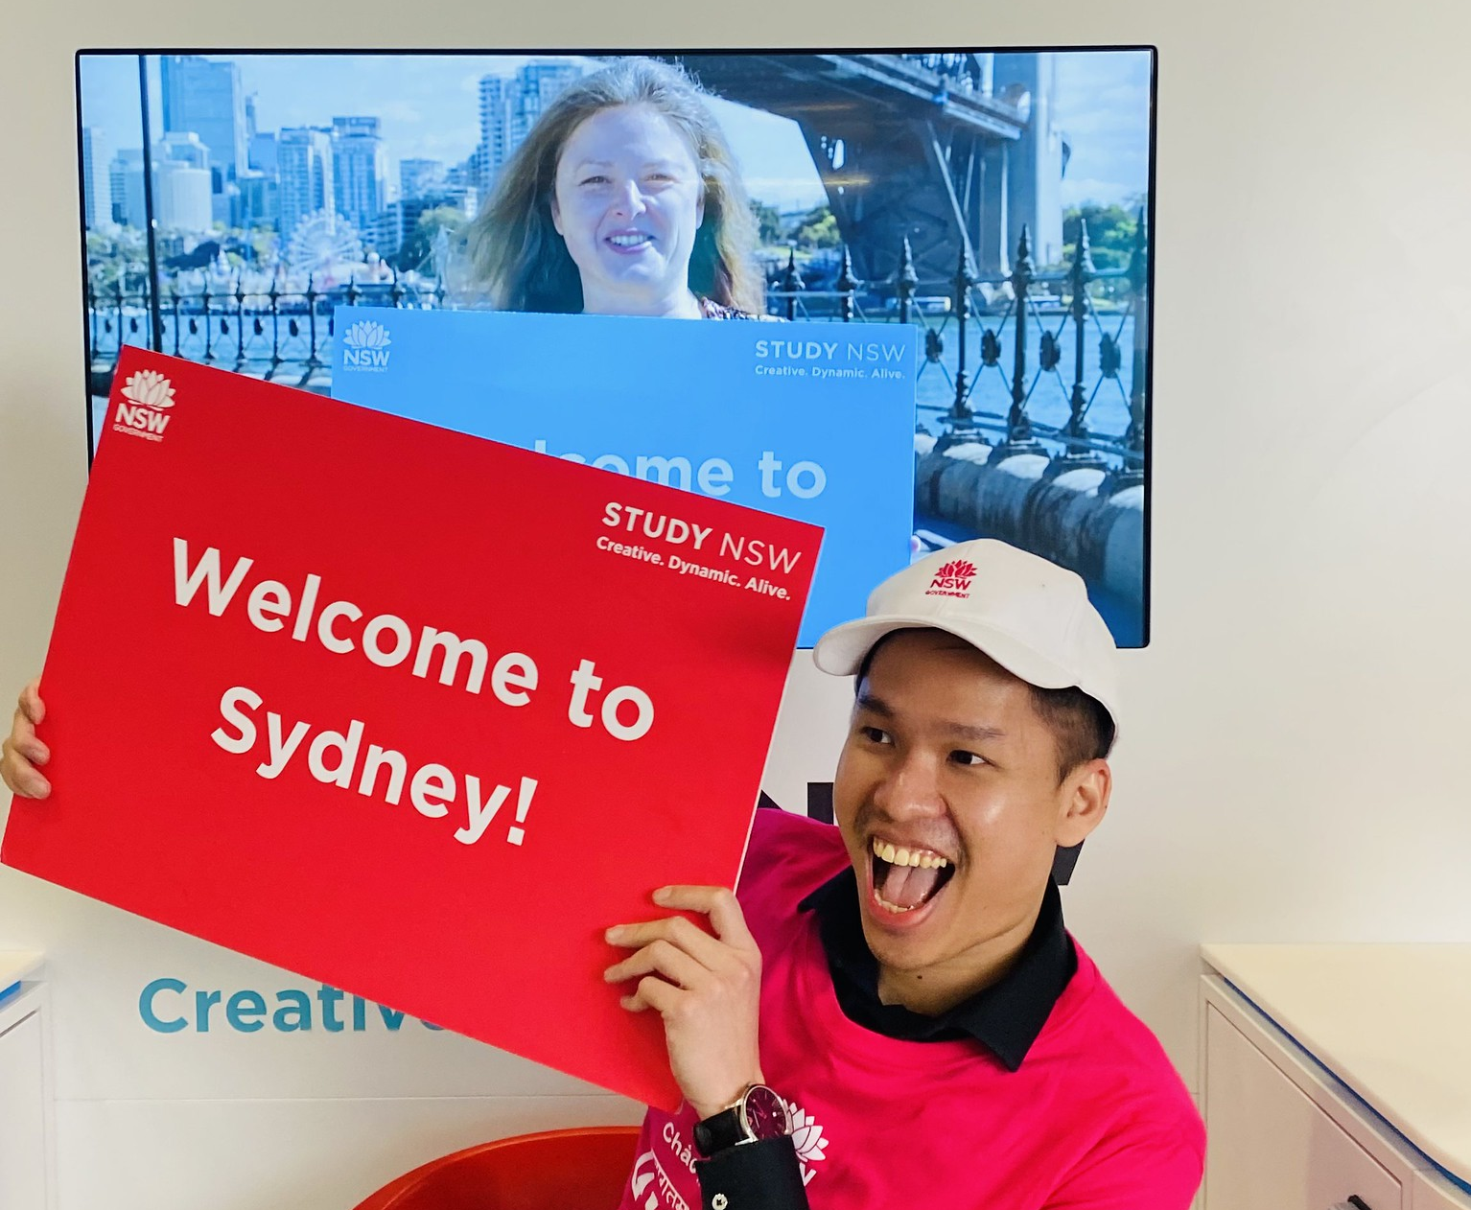
02
This section is for current international students looking to volunteer

Slide 7
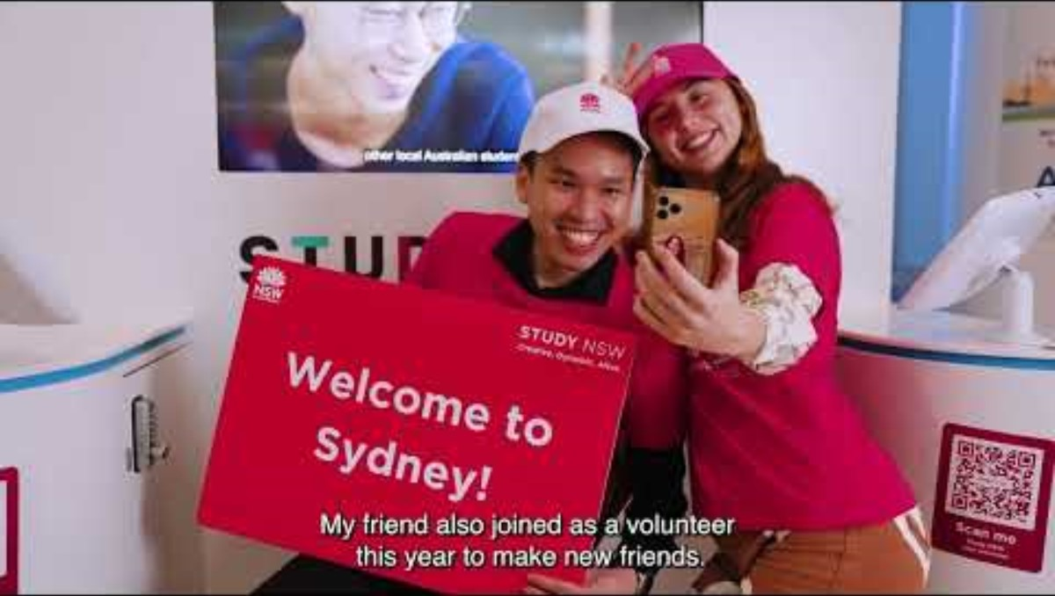
Volunteer with Study NSW

Slide 8
What's involved?
Who can volunteer?
Volunteer at the Airport Welcome Desks
All international students who are studying and living in NSW.
Why volunteer?
Scan the QR code below and complete the expression of interest form on the Study NSW website.
Complete 30 hours of volunteering and receive formal recognition and a certificate from the NSW government.
Make friends and gain valuable work experience and employability skills.
Complete 30 hours of volunteering and gain access to free customer service TAFE training.
Our friendly volunteers assist arriving international students with questions and general enquiries including transport, accommodation, maps and general advice.

Slide 9

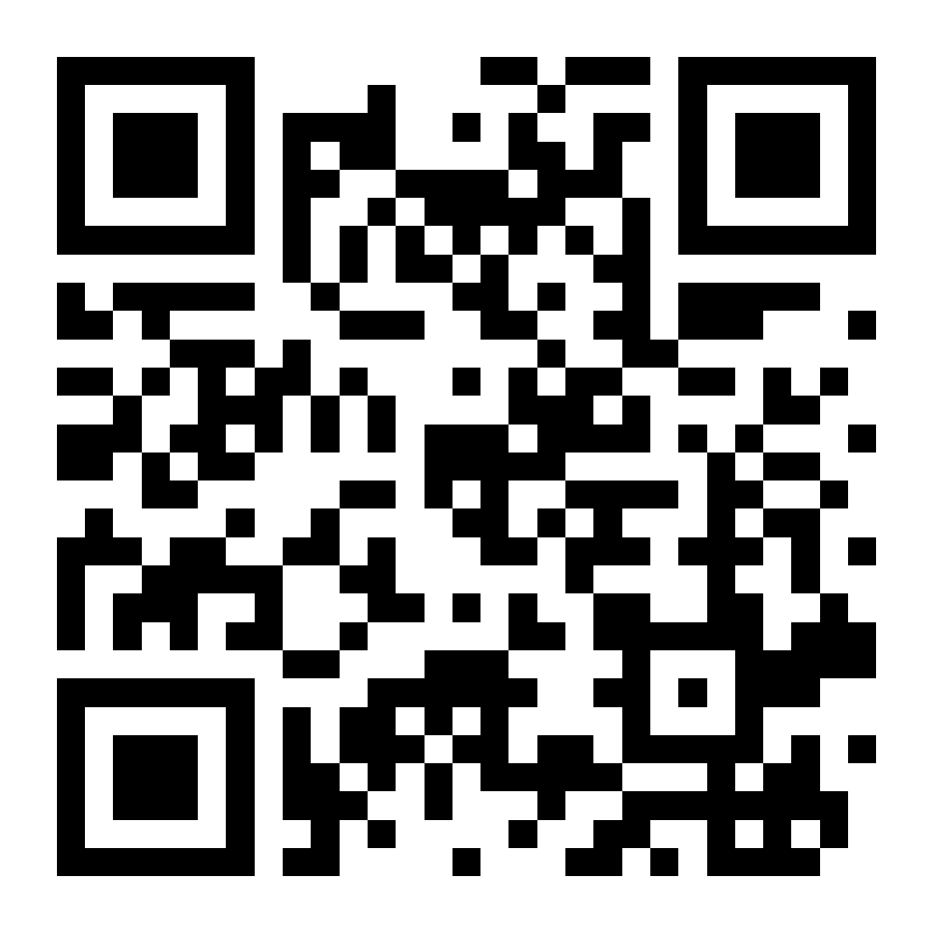
Connect with Study NSW
Visit our website ww.study.nsw.gov.au
Subscribe to our mailing list www.study.nsw.gov.au/subscribe
Follow Study NSW on Facebook, Instagram, LinkedIn and WeChat

